Slide 1
What-IF Test
UI Design Proposal

Slide 2
Current Type 2 Design
Type 2 UI/Grid design consist of Parent Grid & its child.
There would be add or update (CRUD) Form for the Parent.
Child of Type 2 UI/Grid would be a Type 1 Grid.
It would have add/update (CRUD) form for the Child.

Slide 3
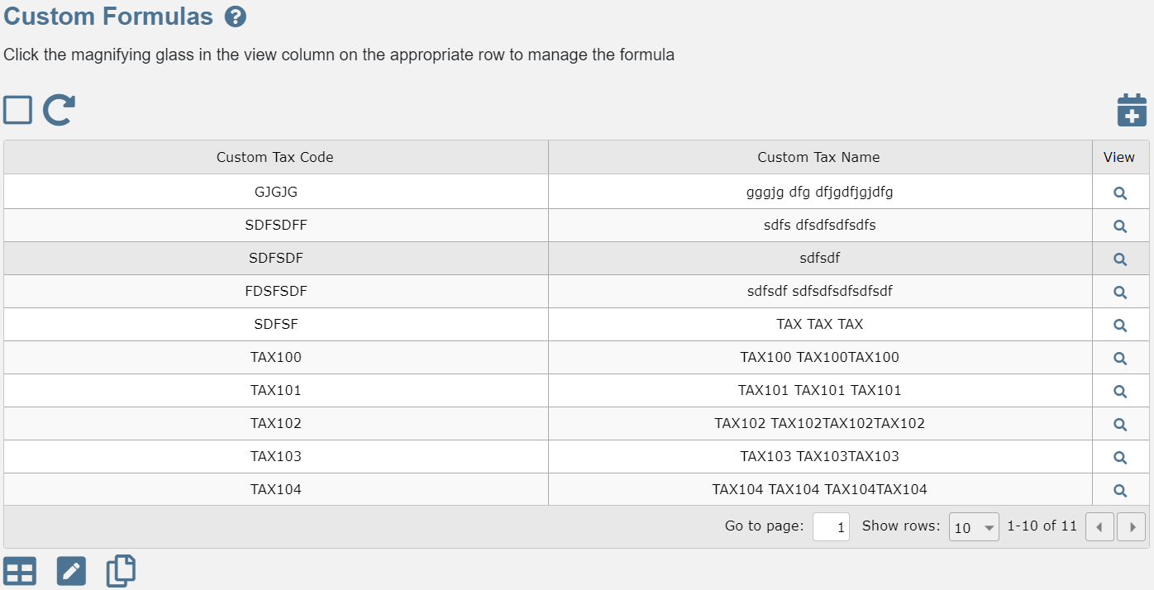
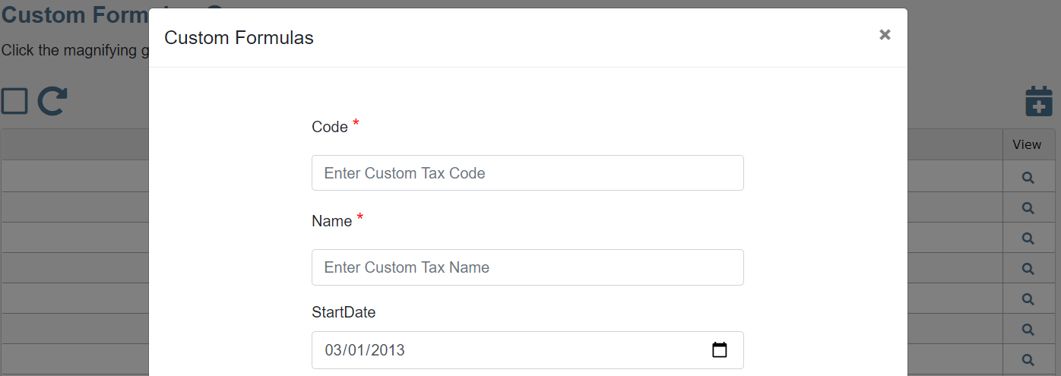
Sample Type 2
Custom Formula – Parent page ➔ Custom Tax Codes
Add New Parent
View Child

Slide 4
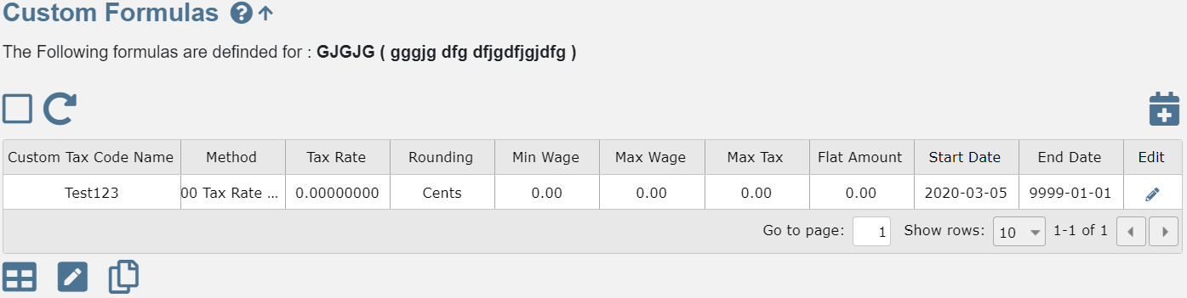
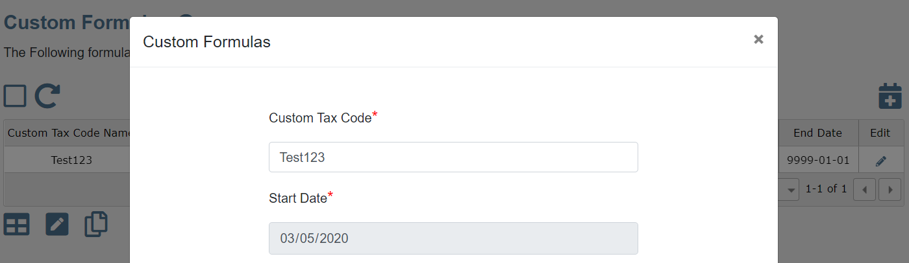
Sample Type 1 Child
Add Child
Custom Formula – Child page
Go Back to Parent
Edit Child

Slide 5
What-IF Test Design
What-IF Test UI/Grid would consist of Parent Grid
There would be add or update (CRUD) Form for the Parent.
It would provide access to more than one Child as Type 1 Grid UI.
Every child would have add/update (CRUD) form for the Child.
And any additional custom component required (Such as additional Button or / Button Bar) in Header or Footer of the child component.
Matches TF 11 UI

Slide 6
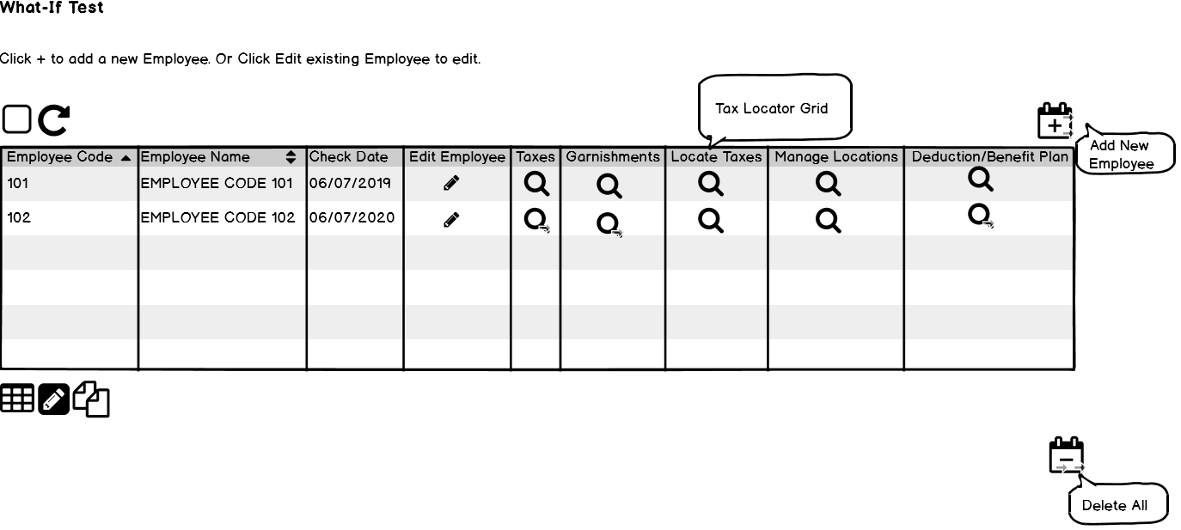
What-IF Test Sample
What-IF Children's
What-If Test – Parent page
Click to View Child – Manage Location
Click to View Child- Locate Taxes
Standard action on Parent Grid
Click to Edit - Parent
Custom Button/Button Bar Component as child to Parent grid
What if Test tab-returns the grid listing the EEs? Do all EEs in a DS display? From Tax Locator grid how does one return to this grid?-or does one have link to return only to EE info? Columns Taxes, Garnishments, Locate Taxes, Manage Locations, Deduction/Ben Plan match the tabs Tax Details. Garnishment Details, (Tax locator & calculate Taxes) Save, Save As, at the Add and Edit screens –Verified)- Back to EE (Verified) View Pdf at Manage taxes (Verified) To select a different EE?

Slide 7
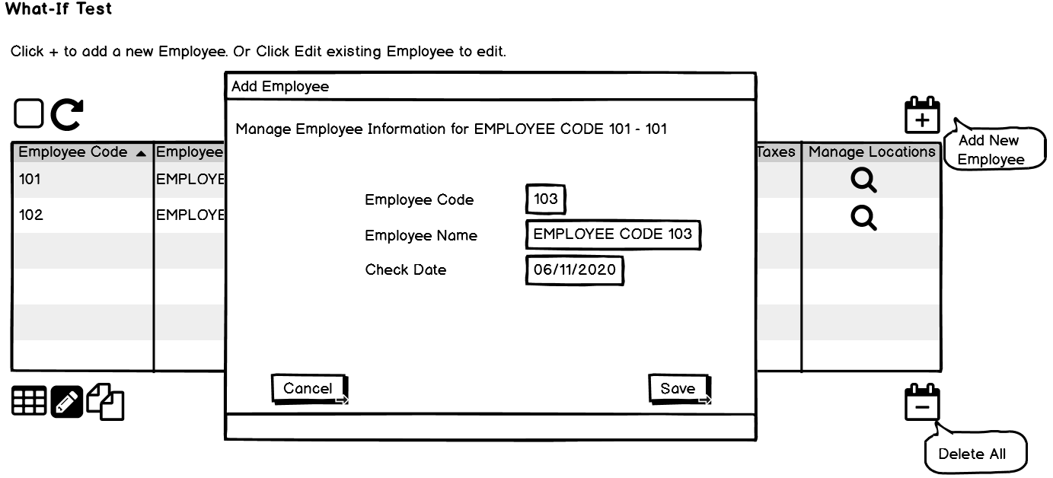
What-IF Test Add/Edit Parent
What-If Test – Add/Edit Parent Form
Click- To Save/Close Parent

Slide 8
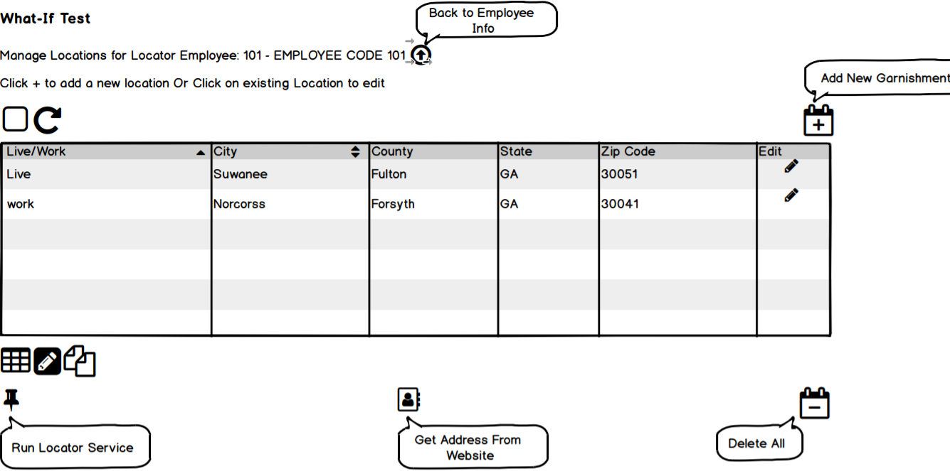
What-IF Test Child – Manage Locations
Sample Child Page – What-If Test Manage Location
Back to Parent
Click to - Add/Edit Location
Custom Button/Button Bar Component as child to Parent grid

Slide 9
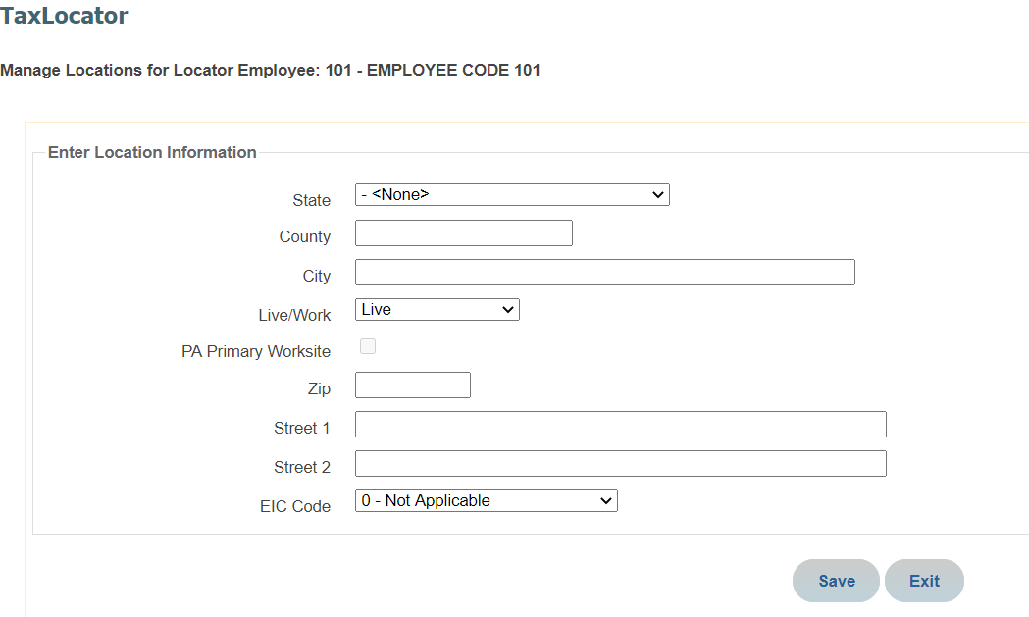
What-IF Test Edit Child- Manage Location
Sample Child Page – What-If Test Edit Location
Back to Parent
Custom Button/Button Bar Component as child to Parent grid

Slide 10
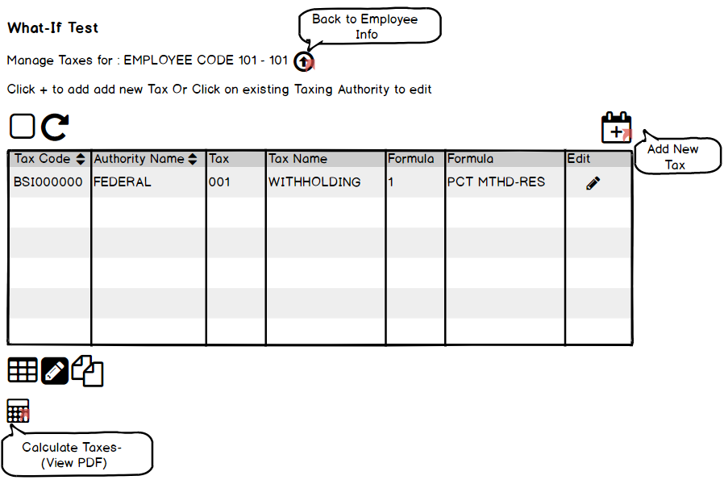
What-IF Test Child – Locate Taxes
Sample Child Page – What-If Test Locate Taxes
Add New Taxes

Slide 11
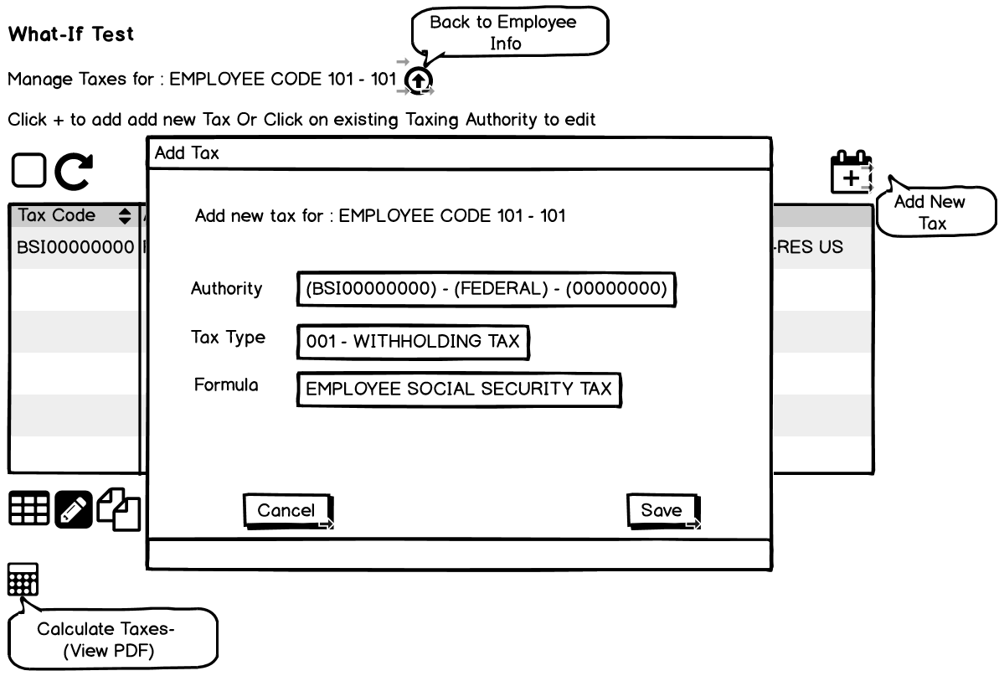
What-IF Test Edit Child- Locate Taxes
Sample Child Page – What-If Test Edit Location
Back to Parent
Custom Button/Button Bar Component as child to Parent grid

Slide 12
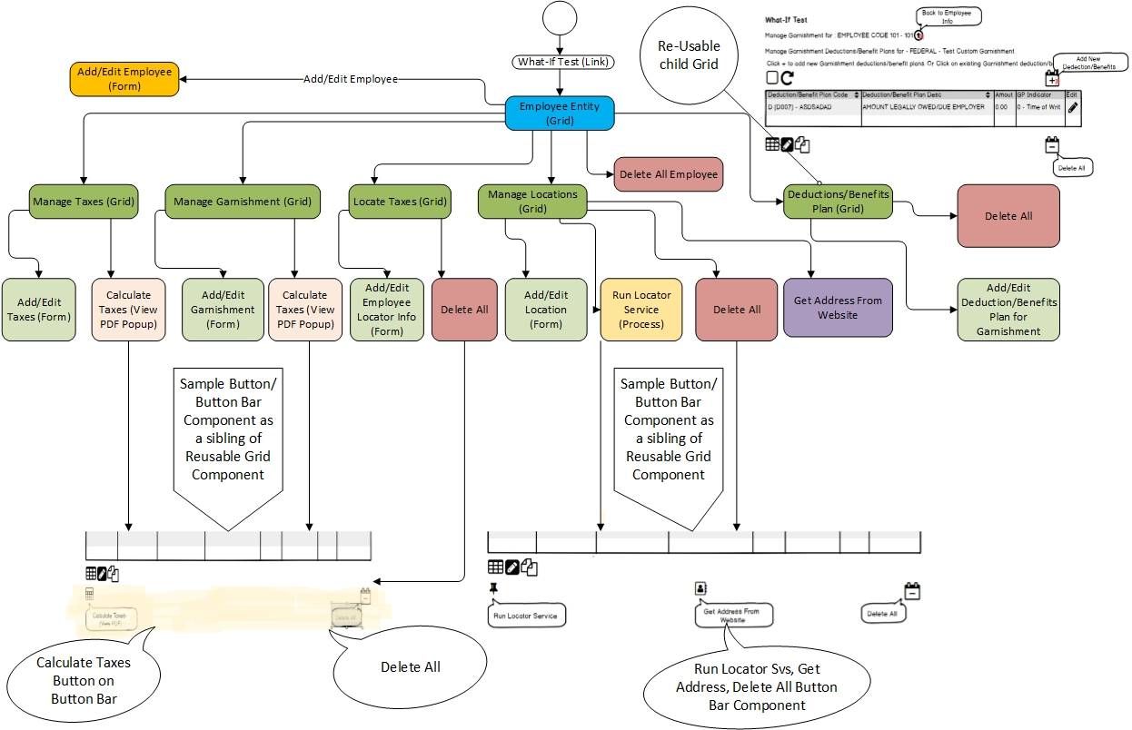
What-If Test Component Blocks

